Slide 1
Проект Яндекс.Презентации

Slide 2
Для кого
Генератор будет полезен для широкого круга лиц, например ученики, не успевшие сделать домашнее задание, учителя, не успевшие подготовиться к уроку.

Slide 3
Конкуренты
Его отличие от других сервисов подобной тематики в грамотности составления, структурированности и приятном дизайне презентаций

Slide 4
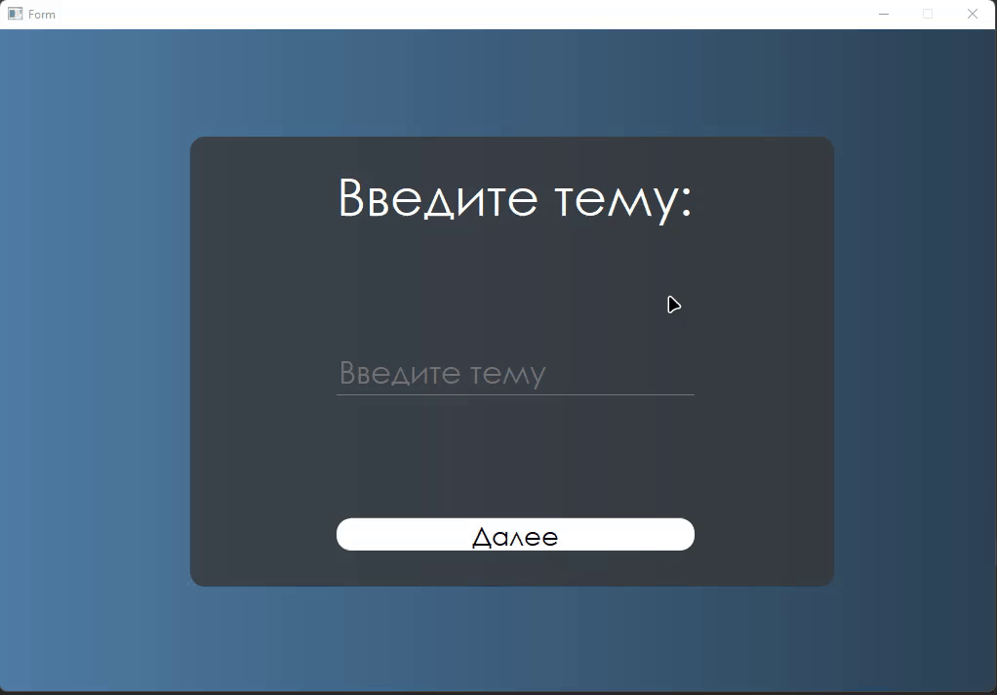
Меню ввода темы
Меню ввода темы презентации
Заголовок
поле для ввода
кнопка "Далее“
Ползунок загрузки

Slide 5
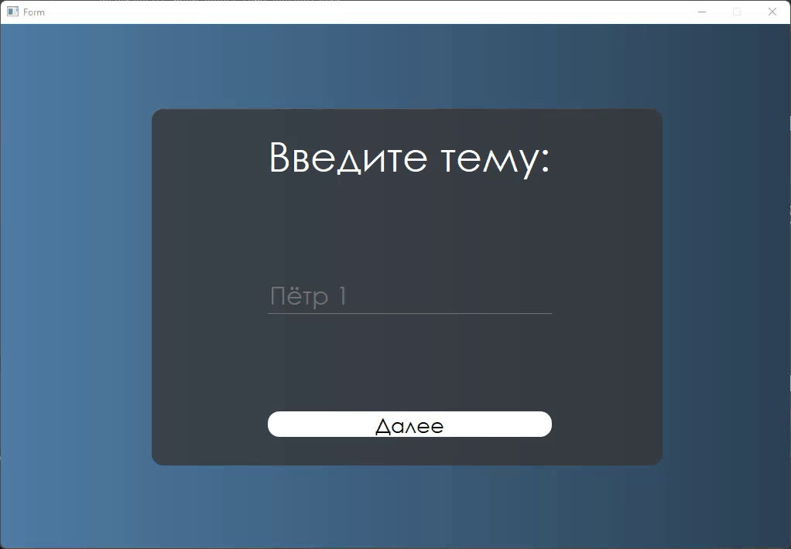
Меню выбора шаблона
Заголовок
Слайдер для выбора шаблона презентации
кнопка "Далее"

Slide 6
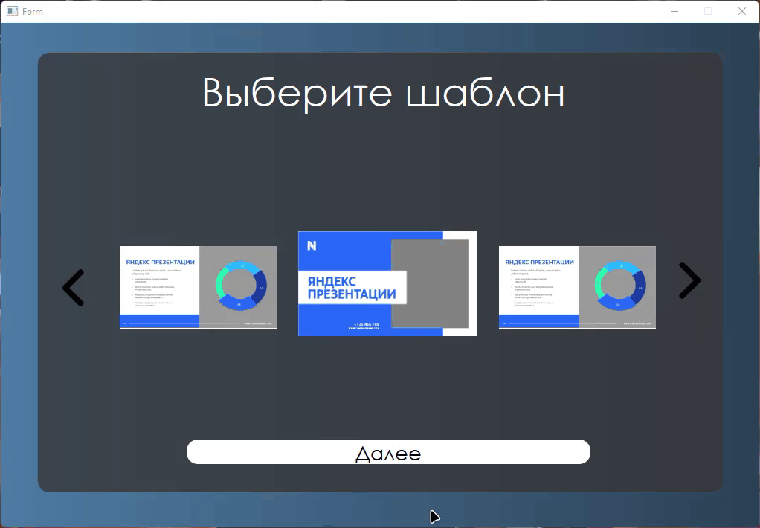
предпросмотр готового результата
Заголовок
Слайдер для просмотра презентации

Slide 7
Пример работы программы

Slide 8
—Someone Famous
“This is a quote, words full of wisdom that someone important said and can make the reader get inspired.”

Slide 9
Now
Mercury is the closest planet to the Sun and the smallest one in the Solar System. This planet's name has nothing to do with the liquid metal, since Mercury was named after the Roman messenger god

Slide 10
Future
Venus has a beautiful name and is the second planet from the Sun. It’s terribly hot, even hotter than Mercury, and its atmosphere is extremely poisonous. It’s the second-brightest natural object in the sky

Slide 11

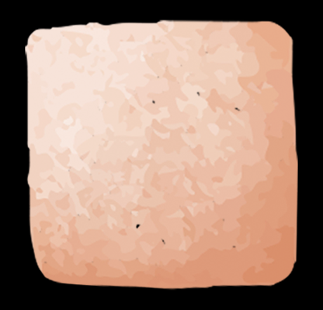
A picture always reinforces the concept
Images reveal large amounts of data, so remember: use an image instead of a long text. Your audience will appreciate it

Slide 12
Major requirements
Jupiter
Mercury
Jupiter is the biggest planet in the Solar System. It's the fourth-brightest object in the sky
Mercury is the closest planet to the Sun and the smallest one in the Solar System

Slide 13
Budget
Mars
Mercury
Jupiter
Despite being red, Mars is a cold planet
It’s the smallest planet of them all
It’s the biggest planet of them all
75%
50%
25%

Slide 14
150,000$
Budget for the project

Slide 15
9h 55m 23s
333,000.000
386,000 km
Is Jupiter's rotation period
Earths is the Sun’s mass
Is the distance between Earth and the Moon

Slide 16
Project goals
 | Goal 1 | Goal 2 | Goal 3
Description | Despite being red, Mars is cold | Neptune is far away from Earth | Venus has a very beautiful name
Budget | 2,000 | 10,500 | 25,000
Deadline | May 15 | July 25 | August 30

Slide 17
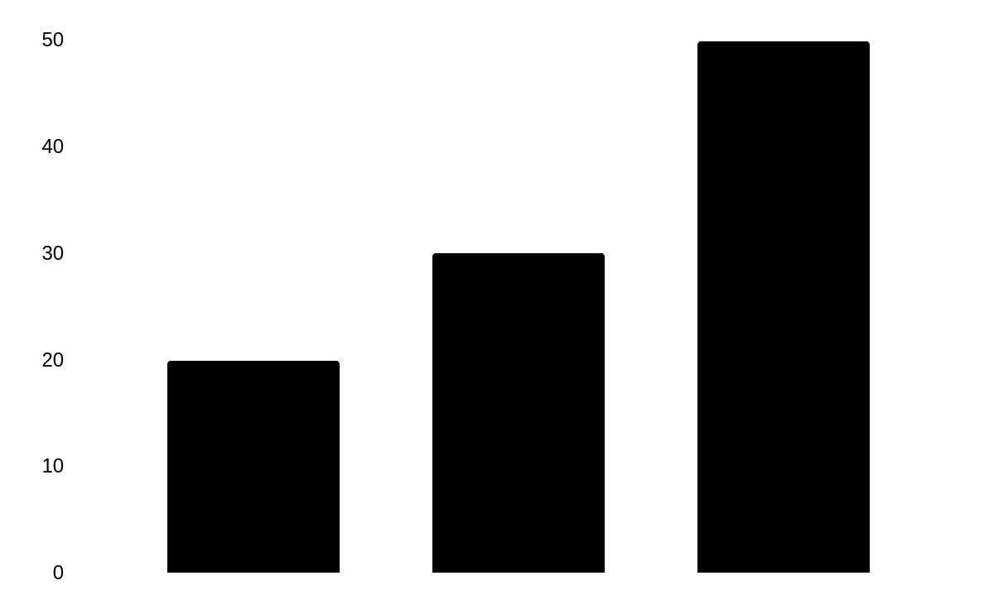
Predicted results
Mercury
20%
It’s the smallest planet in the Solar System
Mars
30%
Despite being red, Mars is actually a cold place
Saturn
50%
Mercury
Mars
Saturn
Saturn is a gas giant and has several rings
To modify this graph, click on it, follow the link, change the data and paste the new graph here, replacing this one. You can see how to modify the graph here

Slide 18
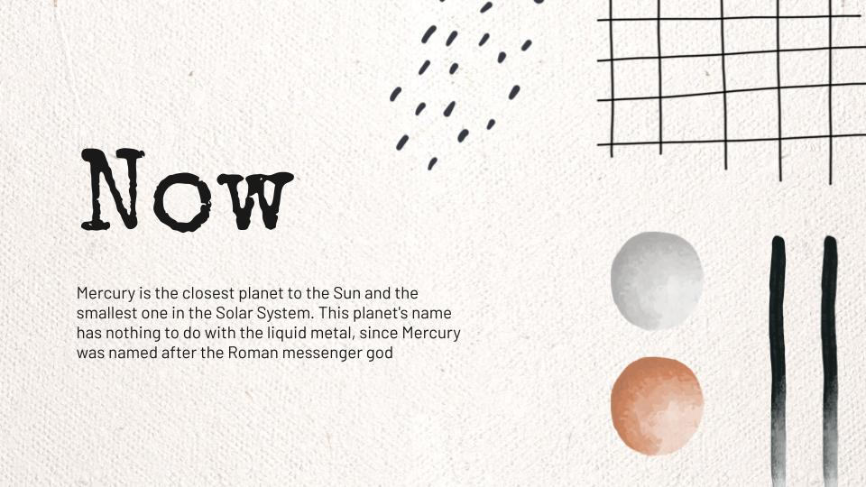
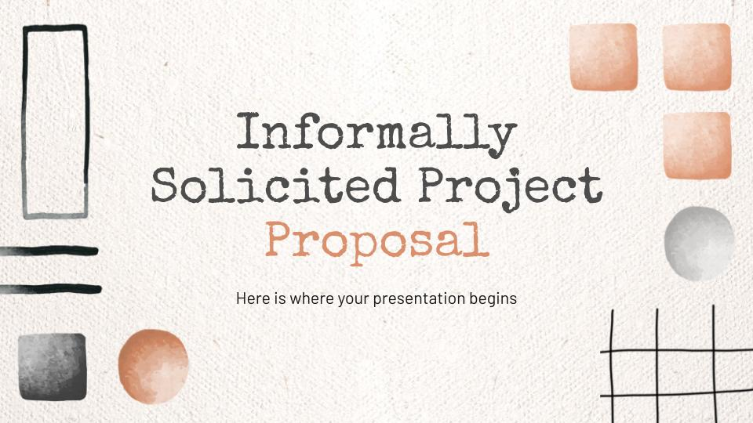
Sneak Peek
Tablet
Desktop
Smartphone
You can replace the image on the screen with your own work. Just right-click on it and select “Replace image”
You can replace the image on the screen with your own work. Just right-click on it and select “Replace image”
You can replace the image on the screen with your own work. Just right-click on it and select “Replace image”

Slide 19
Project stages
Mars
Mercury
Venus
Saturn
Despite being red, Mars is actually a very cold place
Mercury is the closest planet to the Sun and the smallest one
Venus is the second planet from the Sun. It’s hot there
Saturn is a gas giant and has several rings

Slide 20
Timeline
1
2
3
2016
2017
2018
Despite being red, Mars is a very cold place
Mercury is the smallest planet in the Solar System
Venus is the second planet from the Sun

Slide 21
This is a infographic
01
02
Mars
Jupiter
Despite being red, Mars is a very cold place
It’s the biggest planet in the Solar System
04
03
Mercury
Neptune
Mercury is the smallest planet in our System
Neptune is the farthest planet from the Sun

Slide 22
Our partners
Mars
Mercury
Saturn
Jupiter
Neptune
Venus
Despite being red, Mars is a very cold place
Mercury is the closest planet to the Sun
Saturn is a gas giant and has several rings
Jupiter is the biggest planet of them all
Neptune is the farthest planet from the Sun
Venus is the second planet from the Sun

Slide 23
This is a map
Mercury
Mercury is the smallest planet in our System
Mars
Despite being red, Mars is actually a cold place
Saturn
Saturn is a gas giant and has several rings

Slide 24

Our team
Jenna Doe
Timmy Jimmy
You can replace the image on the screen with your own
You can replace the image on the screen with your own

Slide 25
Thanks
Do you have any question?
addyouremail@freepik.com
+91 620 421 838
yourcompany.com
Please keep this slide for attribution

Slide 26

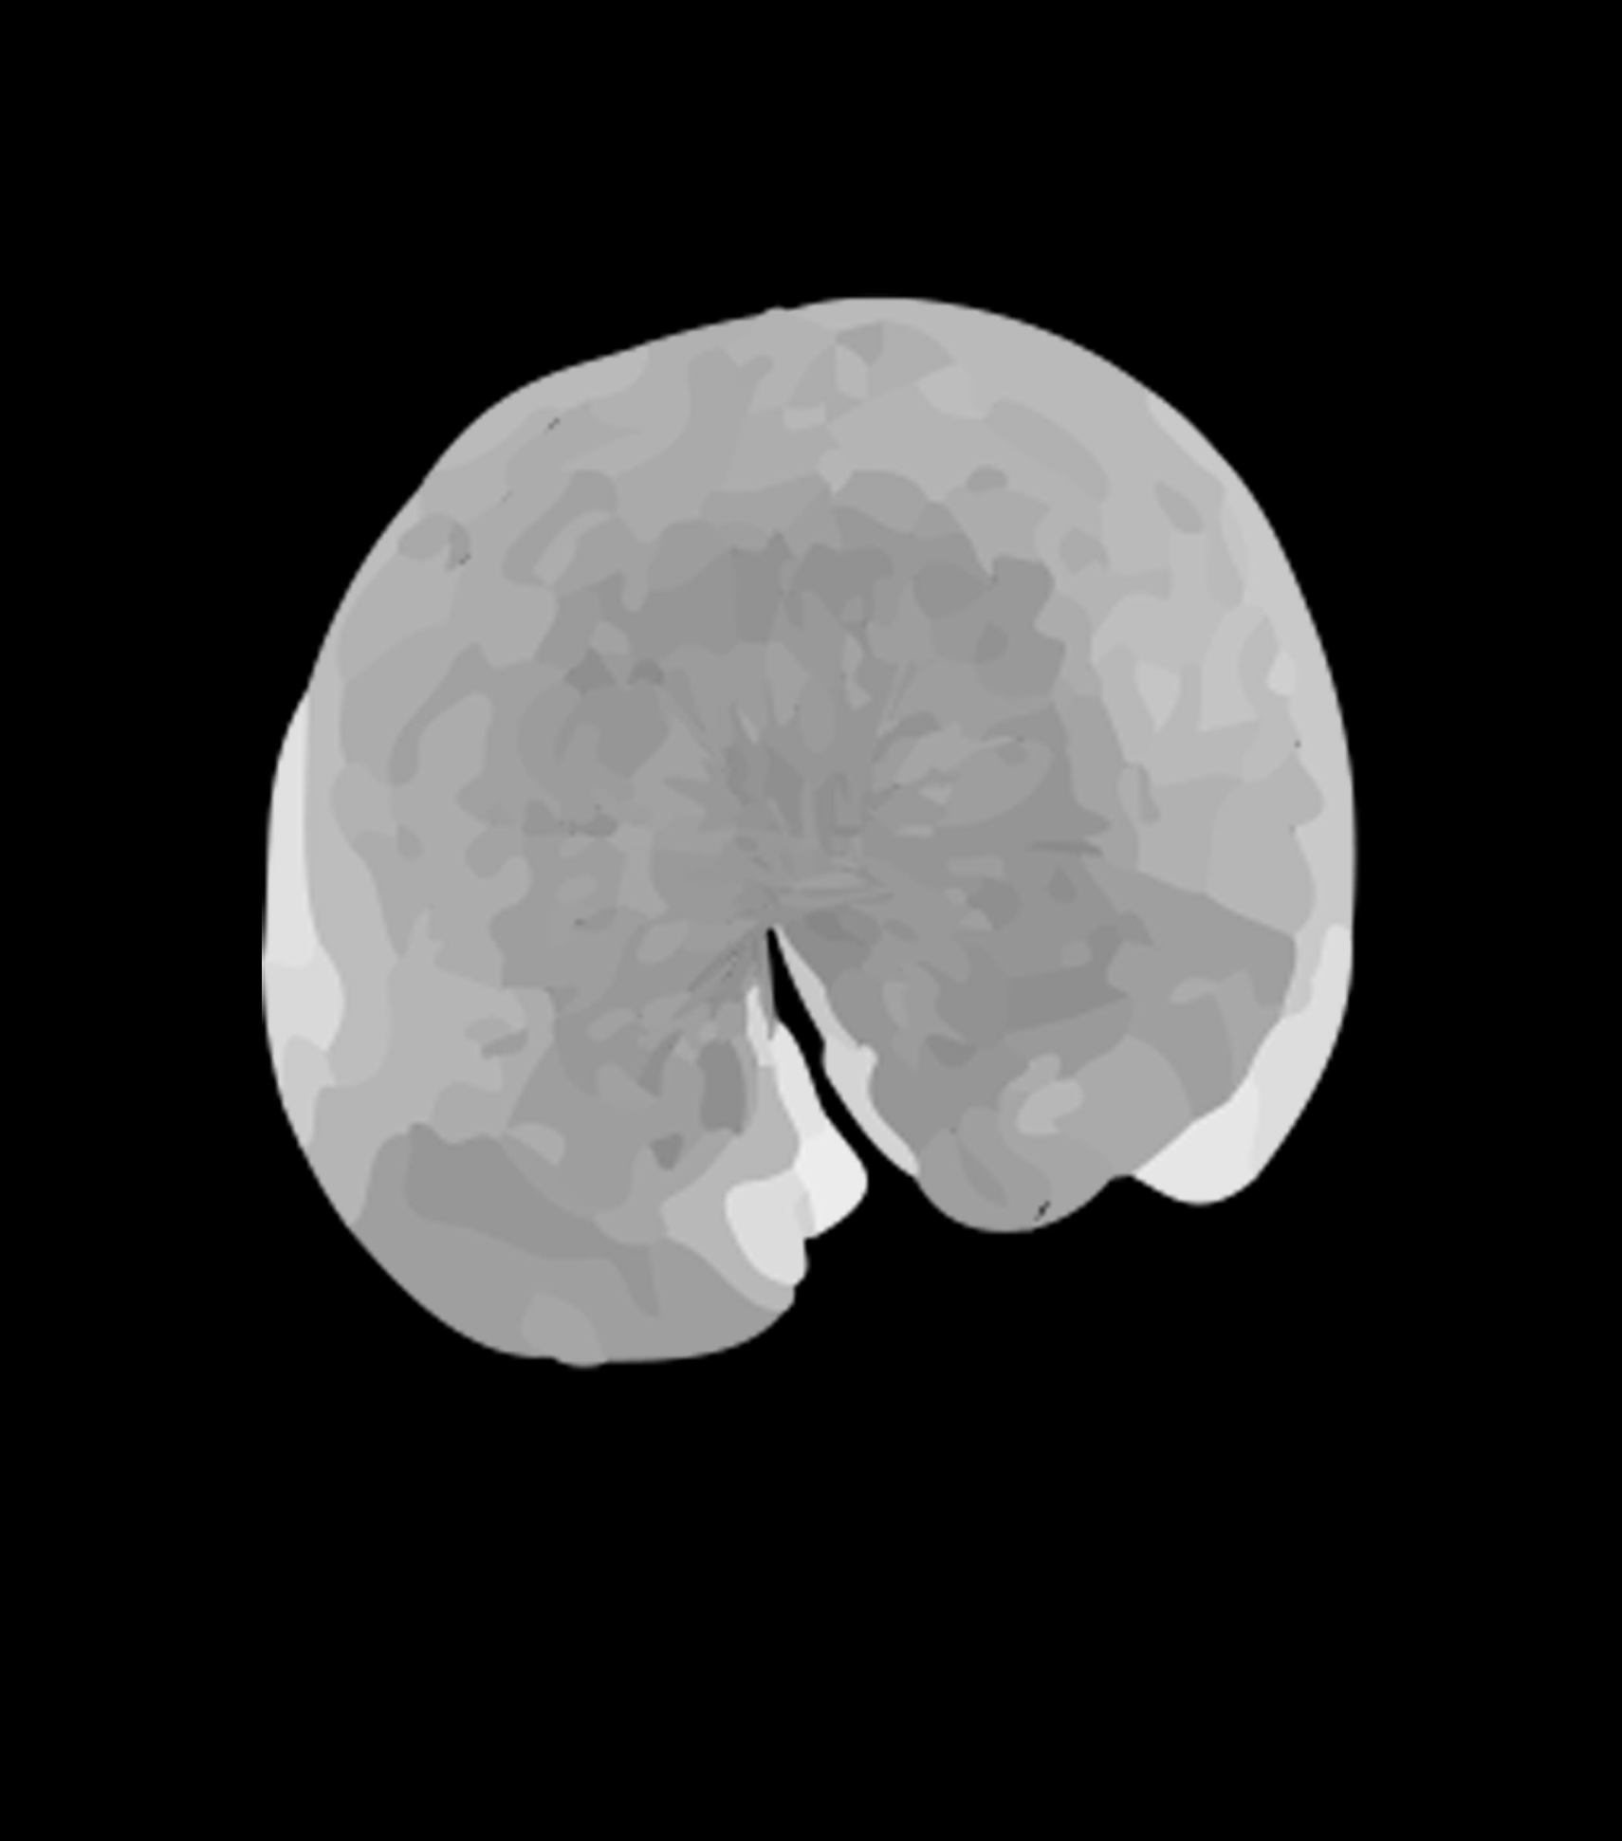

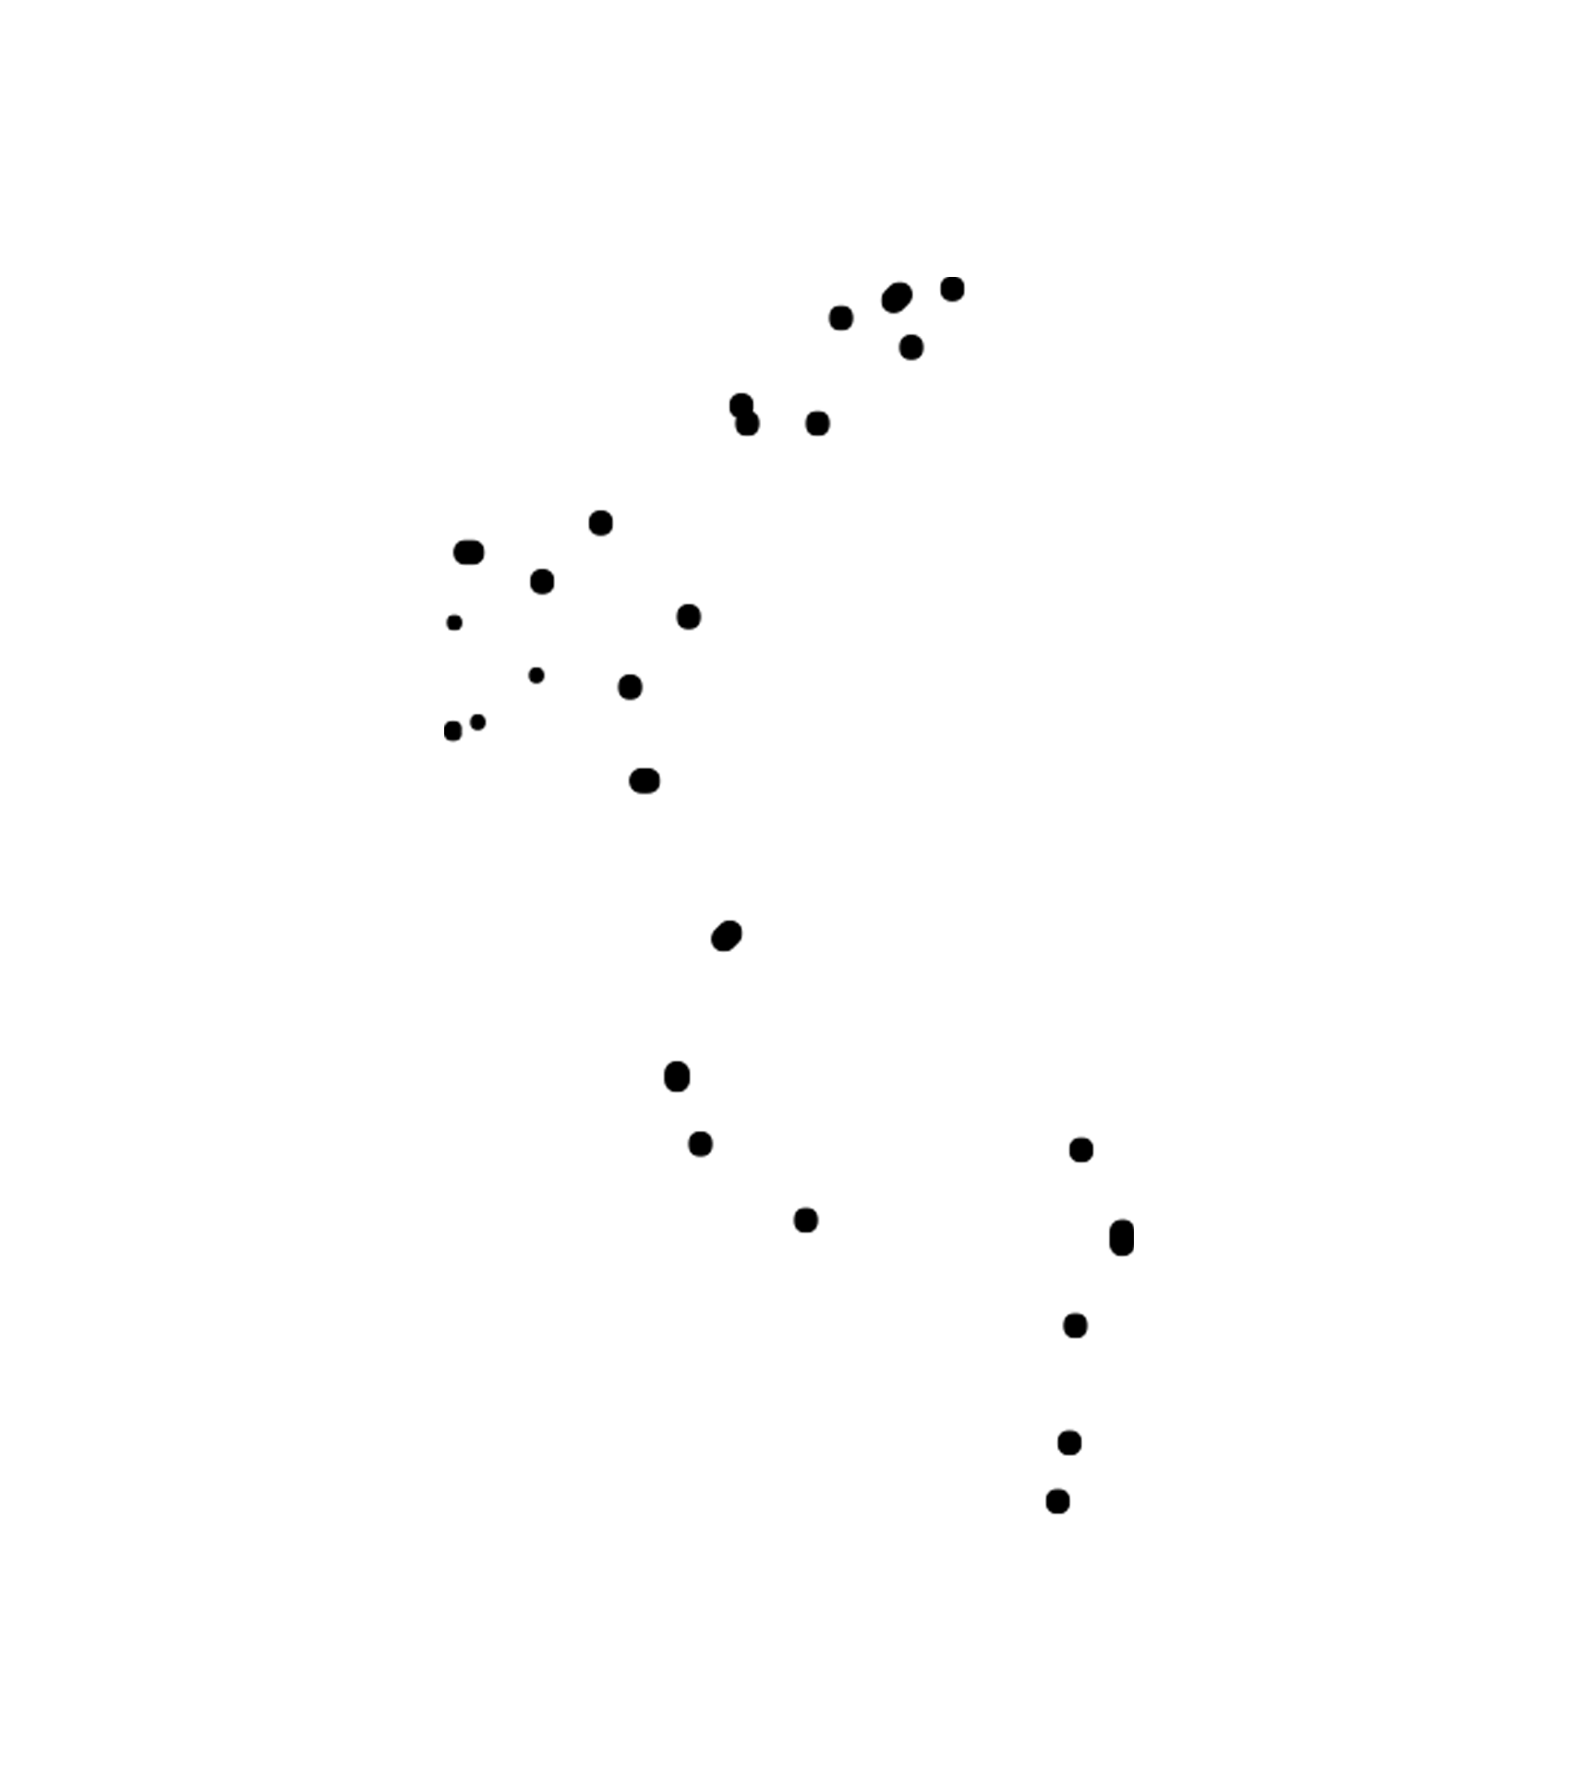
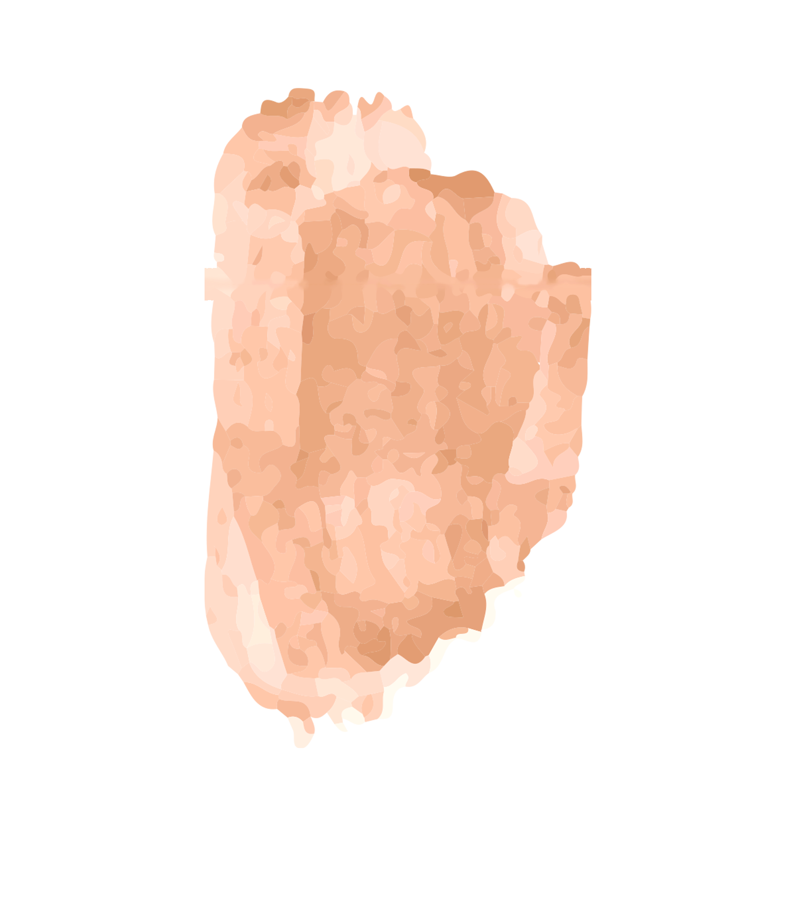
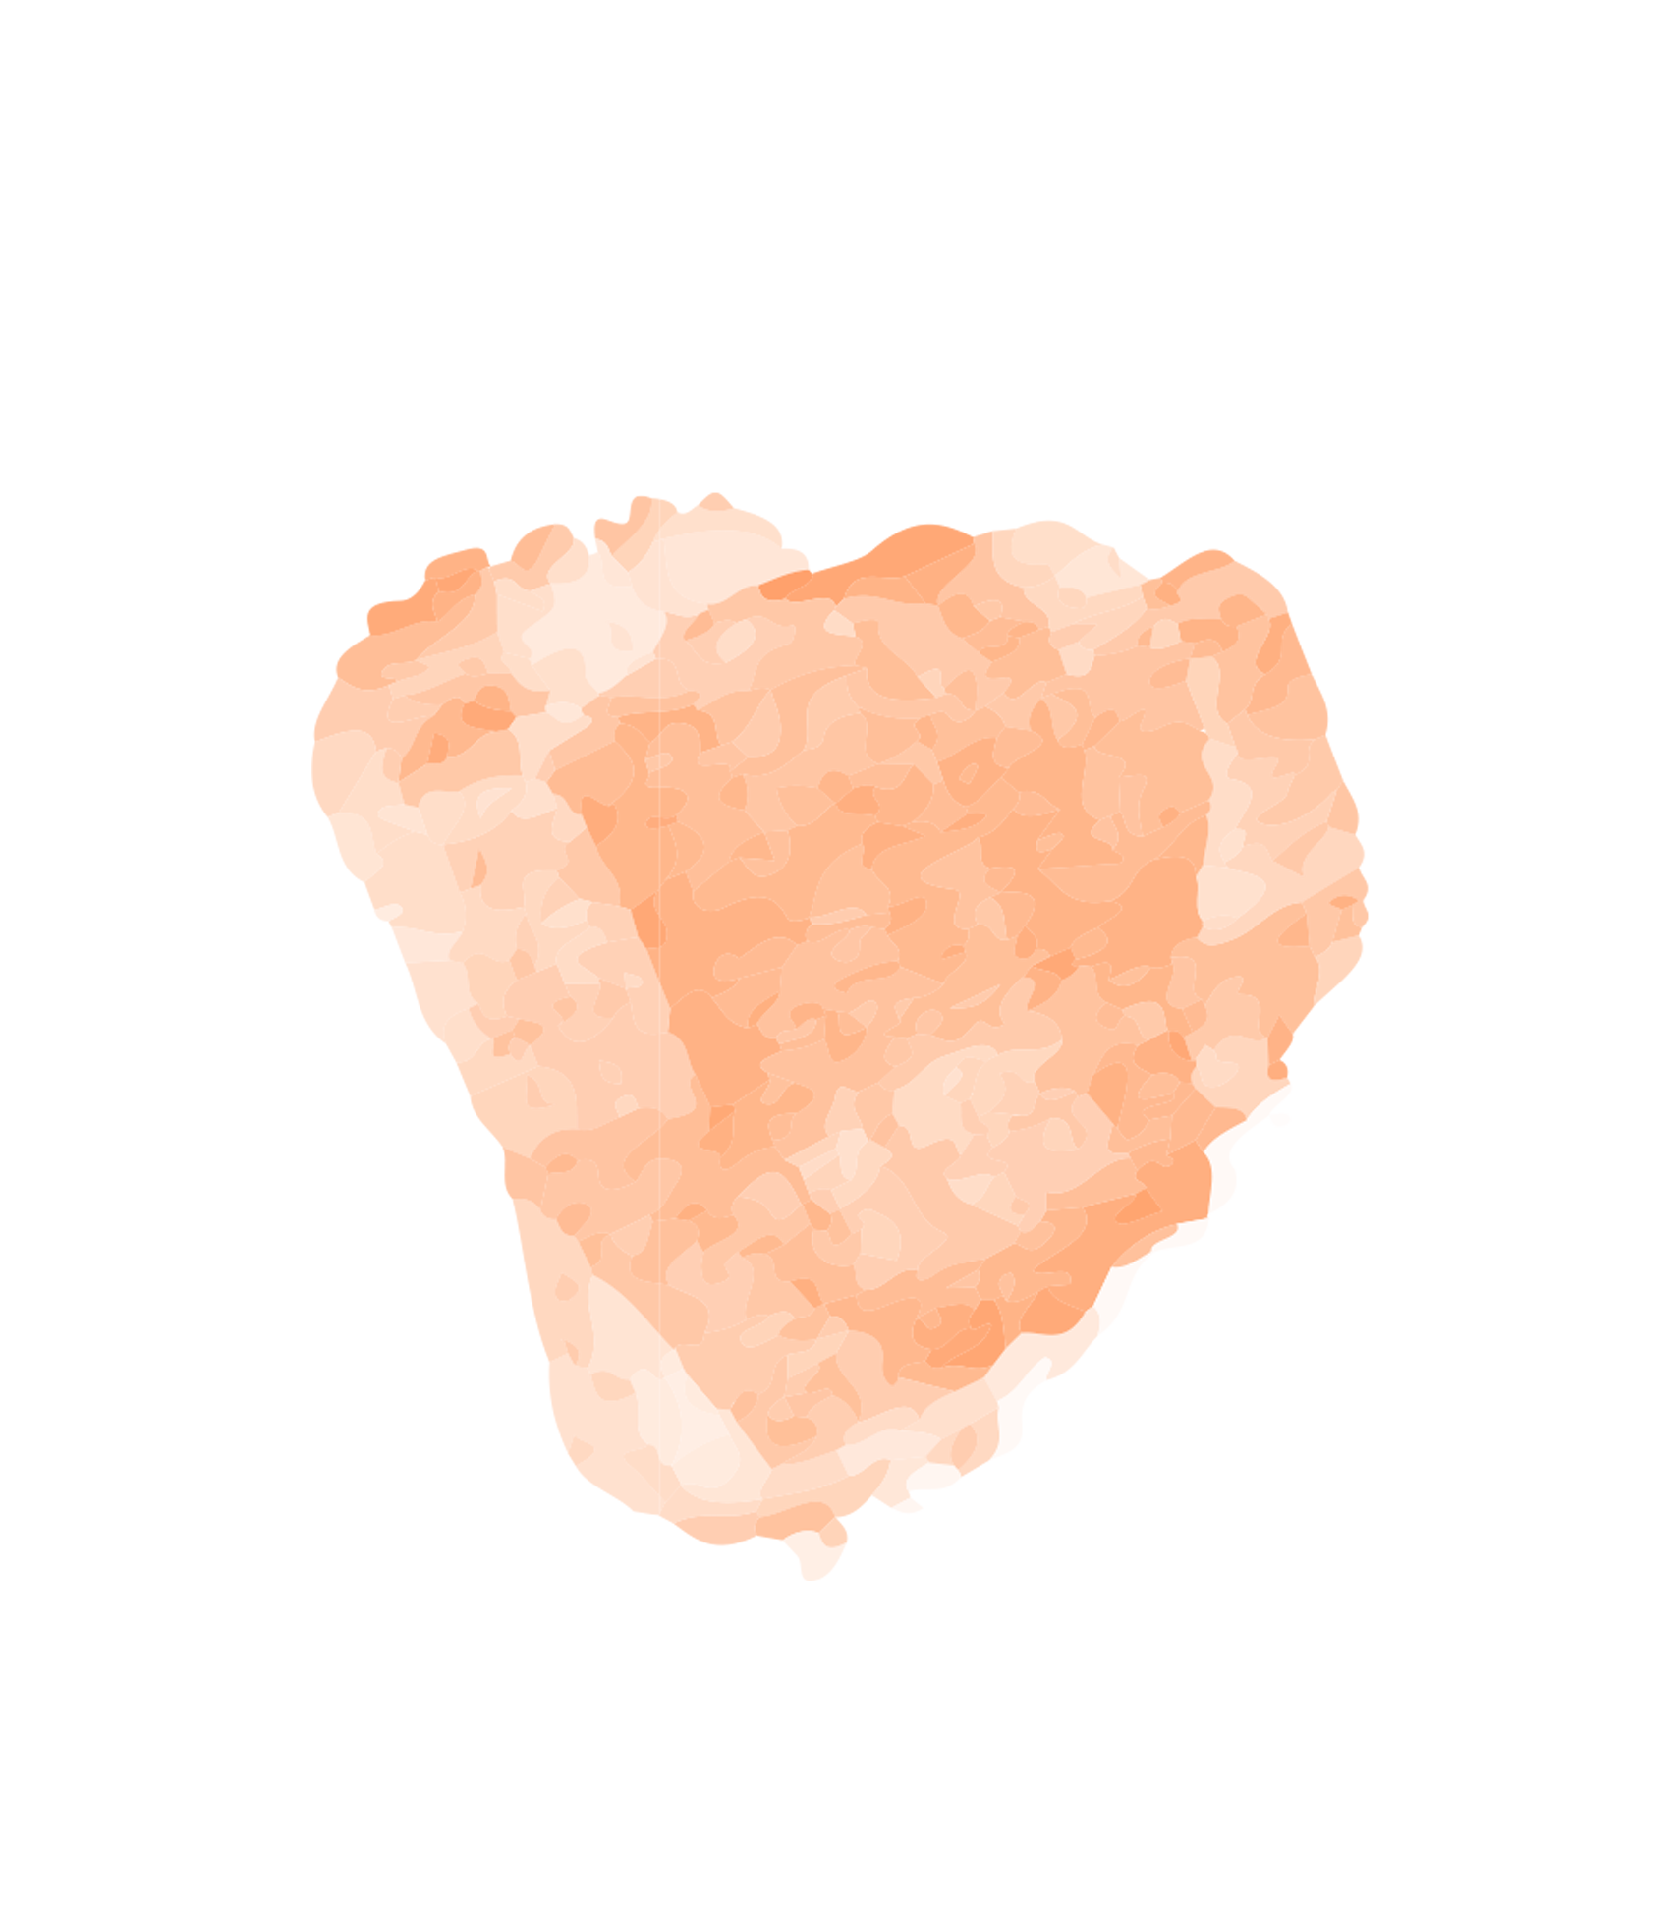
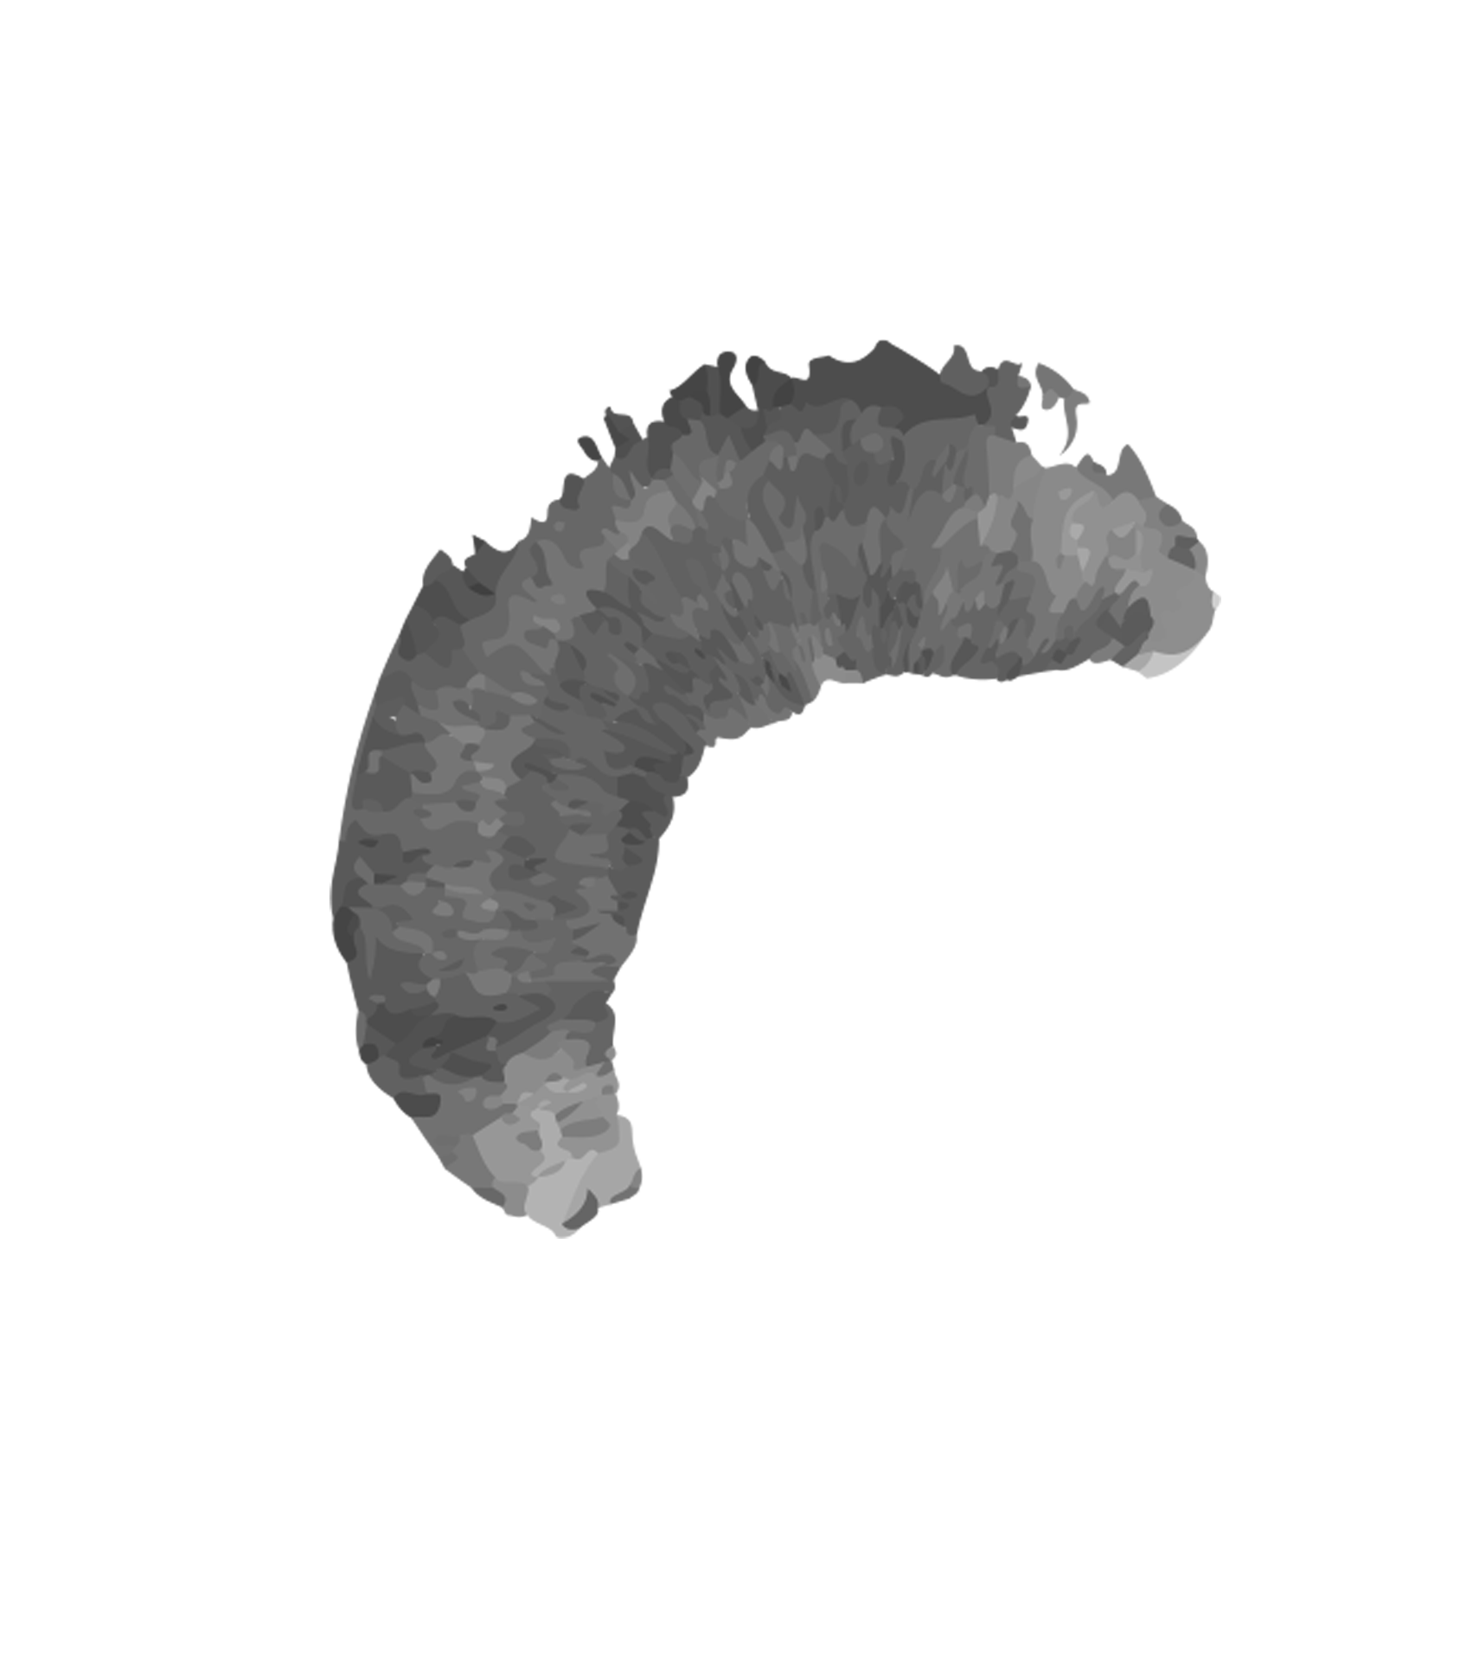
Alternative resources

